Slide 1
PostgreSQL

Slide 2
What is postgre SQL
PostgreSQL is an advanced, enterprise-class, and open-source relational database system. PostgreSQL supports both SQL (relational) and JSON (non-relational) querying.
PostgreSQL is a highly stable database backed by more than 20 years of development by the open-source community.
PostgreSQL is used as a primary database for many web applications as well as mobile and analytics applications.

Slide 3
PostgreSQL CREATE TABLE
A relational database consists of multiple related tables. A table consists of rows and columns. Tables allow you to store structured data like customers, products, employees, etc.
syntax of the CREATE TABLE statement:
CREATE TABLE [IF NOT EXISTS] table_name (
column1 datatype(length) column_contraint,
column2 datatype(length) column_contraint,
column3 datatype(length) column_contraint,
table_constraints
);

Slide 4
PostgreSQL CREATE TABLE
PostgreSQL CREATE TABLE examples
We will create a new table called accounts that has the following columns:
user_id – primary key
username – unique and not null
password – not null
email – unique and not null
created_on – not null
last_login – null

Slide 5
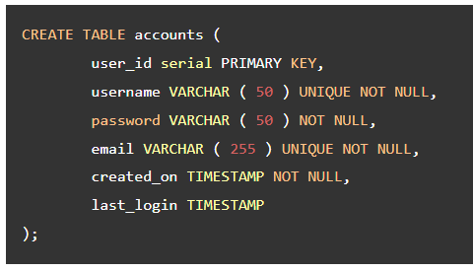

Slide 6
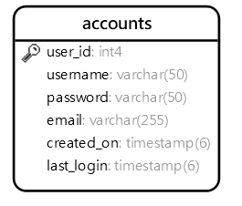

Slide 7
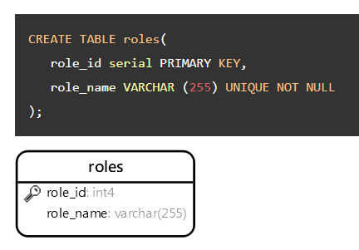

Slide 8
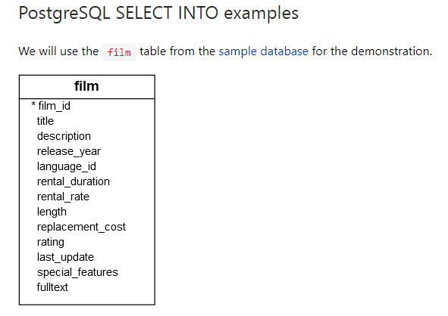

Slide 9
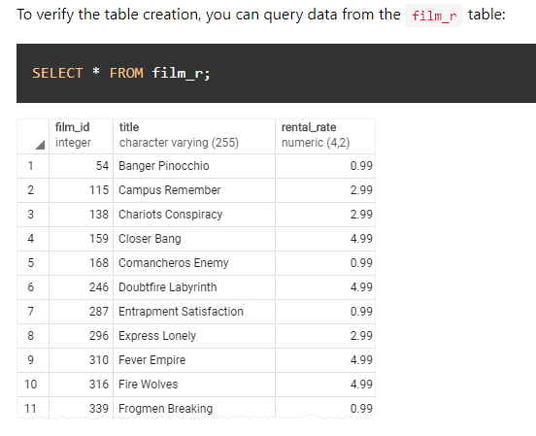

Slide 10
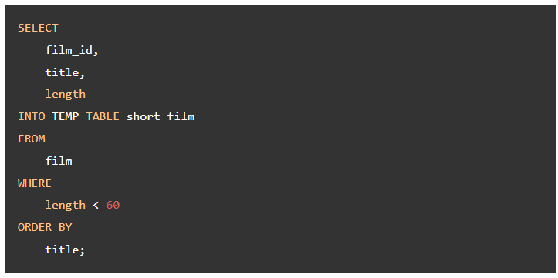

Slide 11
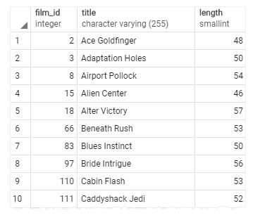

Slide 12
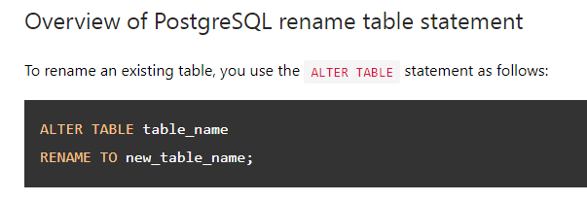

Slide 13
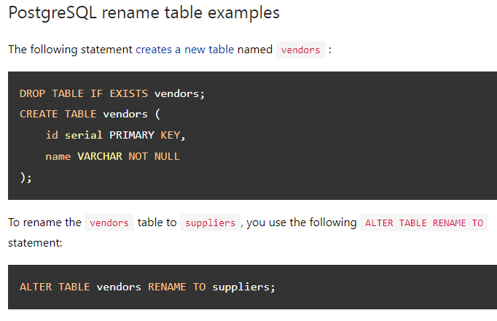

Slide 14
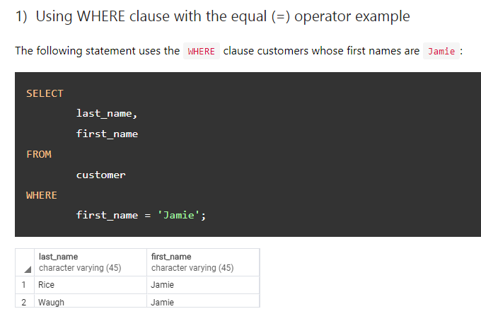

Slide 15
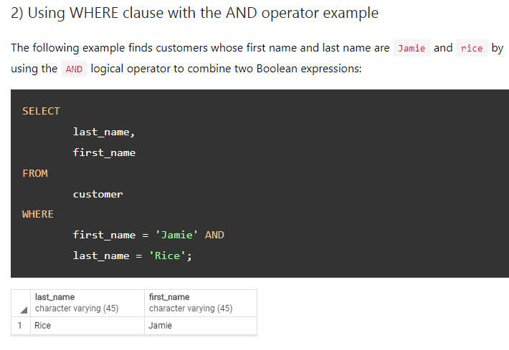

Slide 16
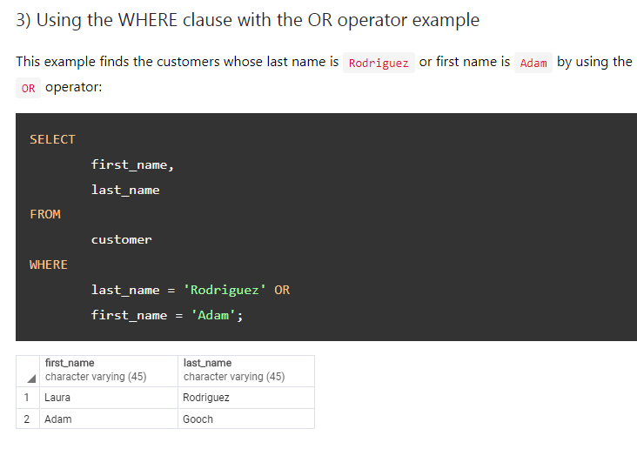

Slide 17
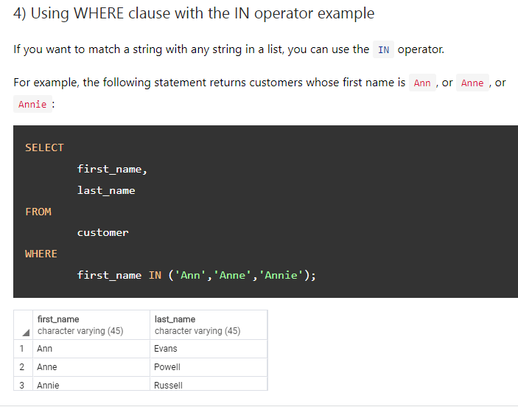

Slide 18
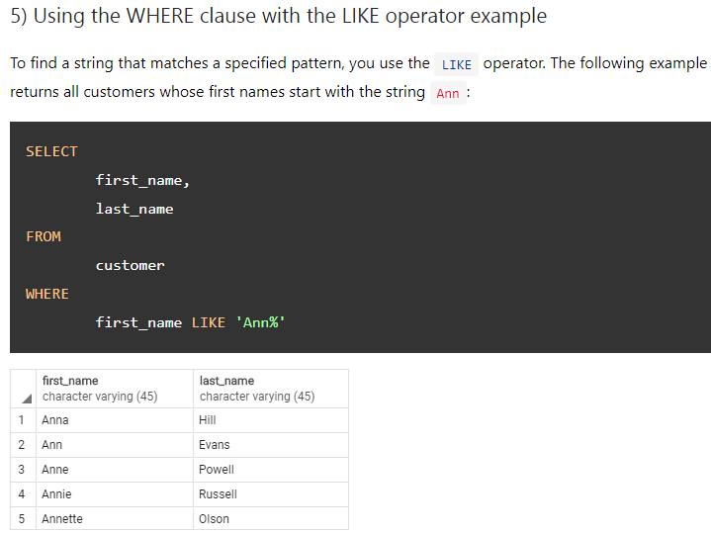

Slide 19
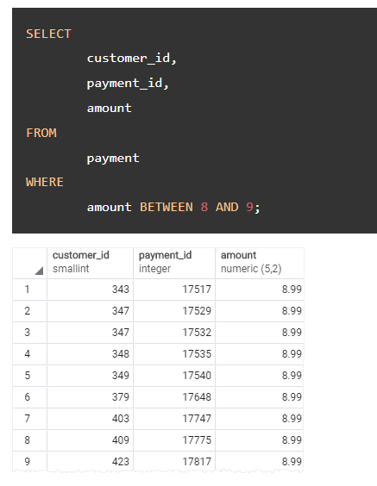

Slide 20
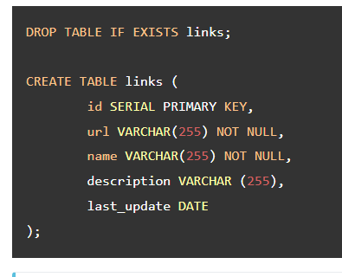
PostgreSQL INSERT statement examples

Slide 21
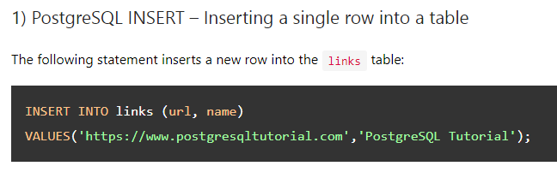

Slide 22
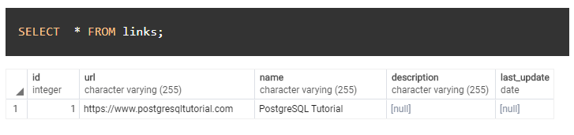

Slide 23
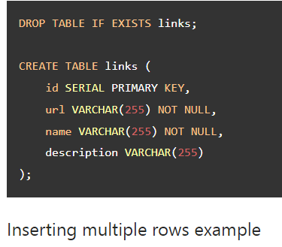

Slide 24
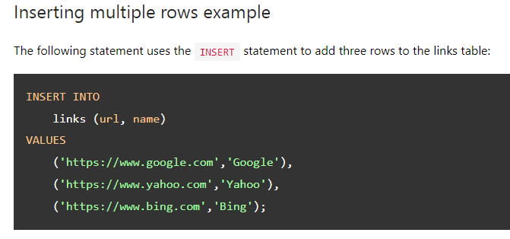

Slide 25
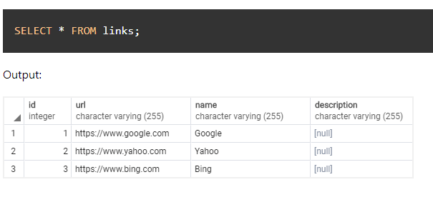

Slide 26
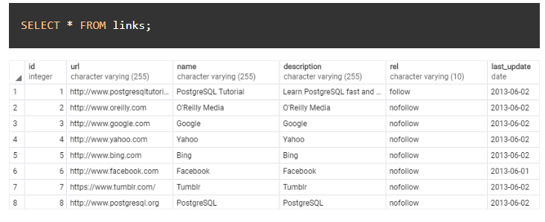

Slide 27
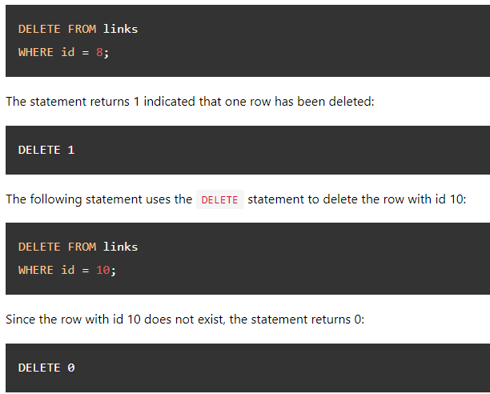

Slide 28
LINK- https://www.postgresqltutorial.com/

